Slide 1
Stop signal tutorial
Summer School 2026

Slide 2
Cognitive neuroscience of healthy ageing
More of a researcher than an invoice-maker
Research interests
Motor and cognitive control
Healthy ageing
Different data types – behavioural, movement, physiological, neural
An EMC user not an EMC developer

Slide 3
Stop signal modelling in EMC
Using a dev branch today
Stop signal part of EMC is undergoing changes
Tutorial paper coming in the next few months
Bit slow at the moment and doesn’t have full functionality
If you’re working with stop signal data – contact us!

Slide 4
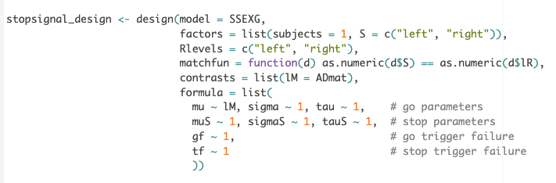
Stop signal modelling
Stop signal model is a race model
Using this part of EMC should feel somewhat familiar
If you’re not a stop signal person, you can use this lesson to consolidate your EMC knowledge ☺

Slide 5
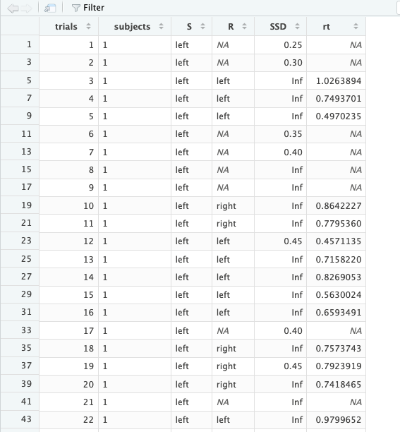
Stop signal data
Requires S and R columns just like the other race models
Go and stop trials are identified by the SSD
SSD must be Inf for go trials
In correct stop trials, R will be NA
In failed stop trials, R will have a response direction
rt in seconds

Slide 6
Stop signal trial types
Correct go – RT
Incorrect go
No response – no RT
Incorrect direction - RT
Correct stop – no RT
Incorrect stop – RT

Slide 7
(switch to R)

Slide 8
Stop signal assumptions
Fundamentally the stop signal models are trying to estimate a latent process: the stop process
This is an instance of an initiated movement being interrupted or cancelled as it was happening
Can be difficult to get participants to do the task properly
Task instructions
Check your data
Easier to fix data problems earlier than later ☺

Slide 9
Common problems
Waiting strategies – participants will slow down and wait for a response
We need a lot of errors – participants don’t like this
Challenging from both a neuroscience and modelling perspective
A consensus guide to capturing the ability to inhibit actions and impulsive behaviors in the stop-signal task
Vebruggen et al, 2019 eLife

Slide 10
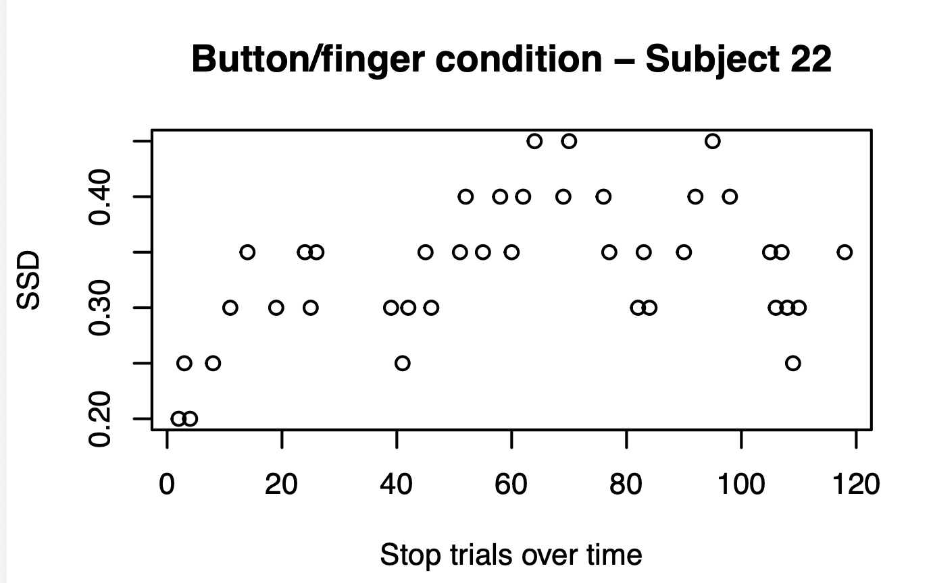
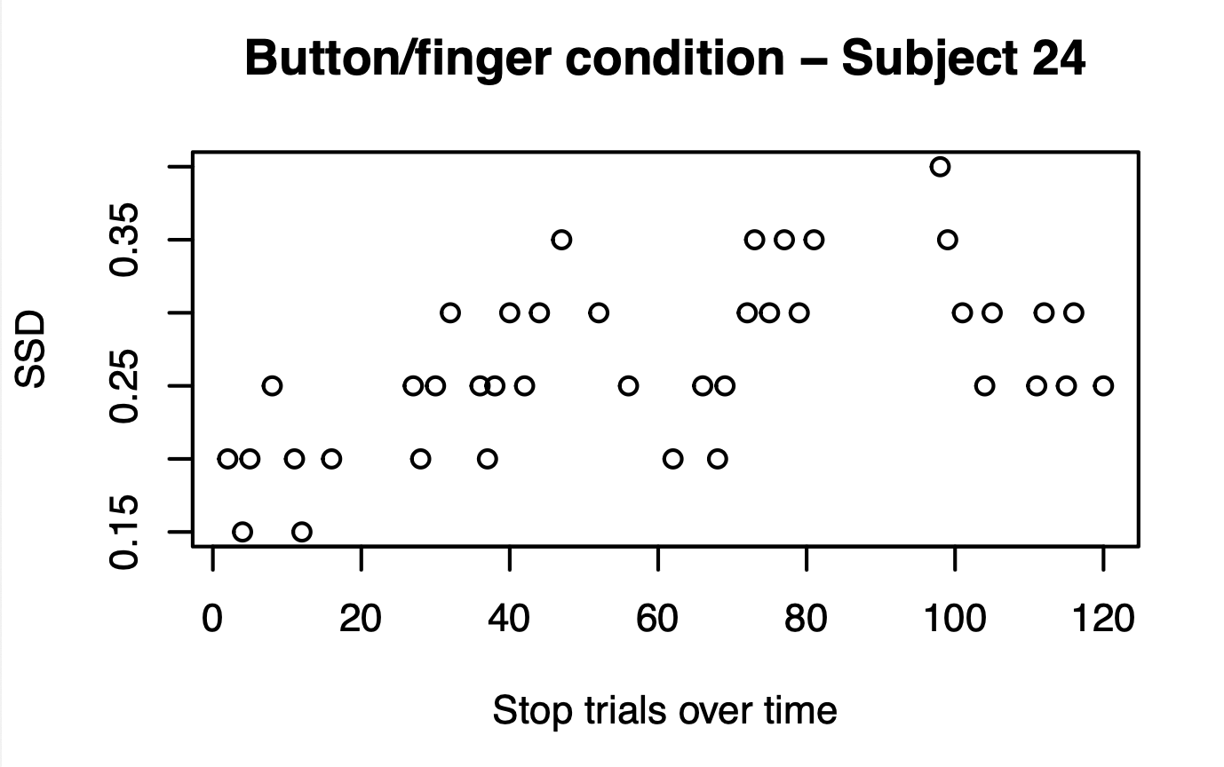
Checking stop-signal delays

Slide 11
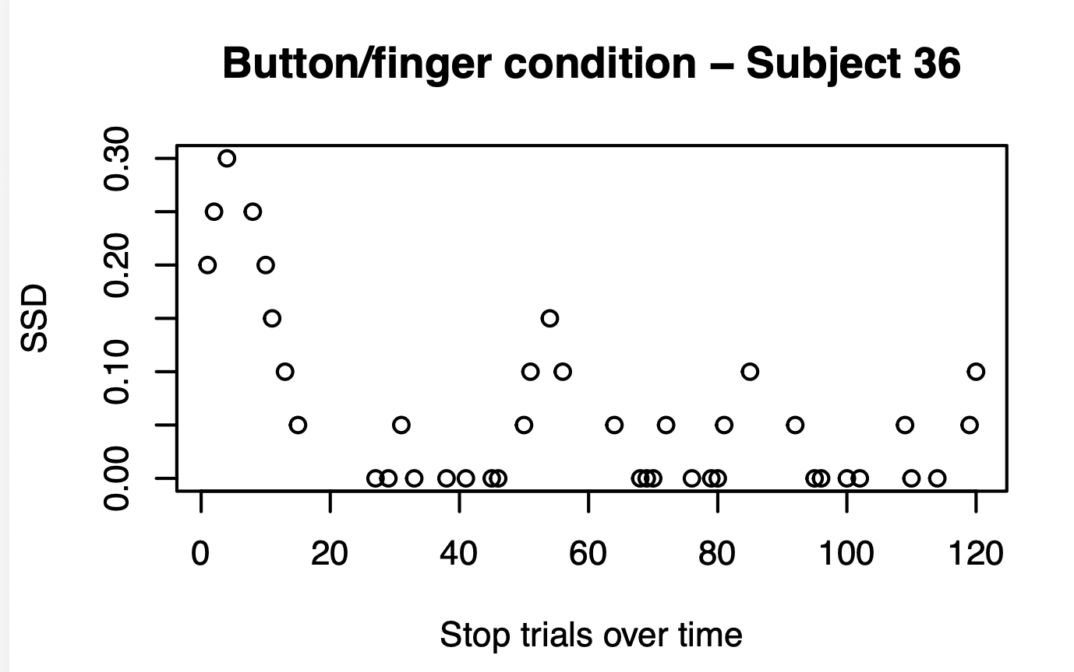
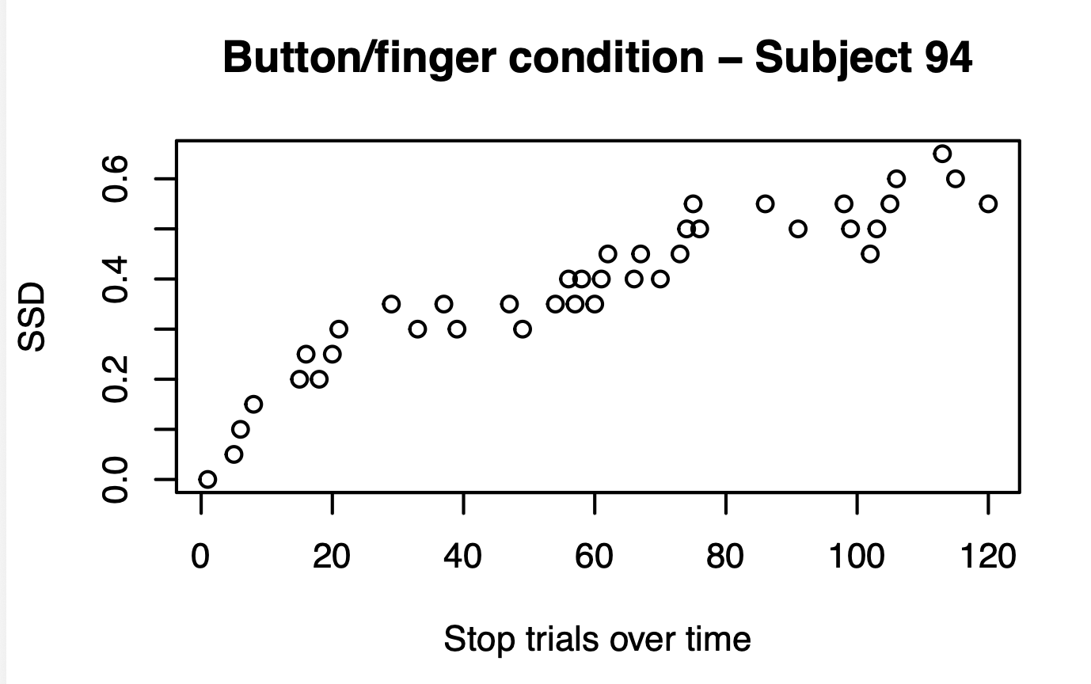
Checking stop-signal delays

Slide 12
Think carefully about your data
Inspecting your individual level data is really important
Try to have a good idea of what participants are doing and what happened with some of the oddball participants
Particularly important with older people or clinical groups – make sure you think through why this may have happened
No easy answer (sorry!)

